Slide 1
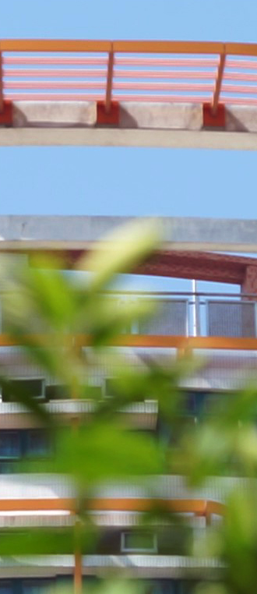
Department of Sociology
Hong Kong Shue Yan University
2023-24 年度
三年級入學(Year 3 entry)同學
修科指引
(入學後兩年內共修62學分畢業)

Slide 2
Year 3 entry – first year
 |  |  |  |  | Credits
Compulsory Courses
 | Language Requirement |  |  |  | 7
 | CHI | 102 |  | First Year Chinese (including Practical Chinese Writing)
 | ENG | 212 |  | English Writing
 | Departmental Core Requirements: |  |  |  | 6
 | SOC | 307 |  | Entrepreneurship and Society
 | SOC | 308 |  | Culture, Heritage and Society
 | Concentration Departmental Elective Courses (Choose 6 credits according to your chosen concentration) |  |  |  | 6
 | Entrepreneurship and Community Concentration
 | SOC | 309 |  | Community Economy
 | SOC | 310 |  | Social Enterprise in Asia
 | SOC | 358 |  | Poverty, Social Policy and Social Innovation
 | Culture, Heritage and Innovation Concentration
 | SOC | 311 |  | Sustainable and Innovative Cities in the Contemporary World
 | SOC | 312 |  | Popular Culture in Asia
 | SOC | 362 |  | Tourism and Culture
 | SOC | 371 |  | Chinese Culture and Society
Non-concentration Departmental Elective Courses* (Choose 12 credits) |  |  |  |  | 12
SOC | 302 | Environmental Sociology | Environmental Sociology
SOC | 313 | Sociology of Education | Sociology of Education
SOC | 321 | Economic Sociology | Economic Sociology
SOC | 333 | Urban Sociology | Urban Sociology
SOC | 334 | Sociology of Deviance | Sociology of Deviance
SOC | 336 | Love, Family and Kinship | Love, Family and Kinship
SOC | 337 | Criminology | Criminology
SOC | 339 | Sociology of Religion | Sociology of Religion
SOC | 356 | Gender Relation | Gender Relation
SOC | 357 | Migration and Mobility | Migration and Mobility
SOC | 360 | Social Change and Modernity | Social Change and Modernity
SOC | 380 | Arts and Everyday Life in the Digital Era | Arts and Everyday Life in the Digital Era
SOC | 470 | Service Learning | Service Learning
Free Elective (Elective courses offered by other departments) |  |  |  |  | 6
Total Credits |  |  |  |  | 37
*The Departmental Elective Courses offered might be subjected to change.

